Slide 1
Deep Learning
<Presenter Name>

Slide 2
Introduction

Slide 3

Agenda
Introduction
Problem Statement
Solution
Components
Implementation
Hands-On Exercises
Discussion

Slide 4
Summary outline
Objectives
Prerequisites
Materials
Knowledge
The requirement of large-scale Deep Learning
E2E Deep Learning solution architectures
Skills
Deploy an environment on Azure for Deep Learning in a single click
Inform use cases for large-scale Deep Learning
Experience
Efficiency & effectiveness of large-scale Deep Learning in a cloud built for HP
Required
Deep Learning framework(s)
Use of GPUs
Workload management via SLURM
Containers
Desirable
???
Presentation & discussion
~1 hour
Guided hands-on session
~3 hours
One-click deployment of infrastructure for use-case motivation

Slide 5
The Problem

Slide 6
Problem Statement
The requirement of large-scale Deep Learning:
Model training and/or inferencing takes prohibitively long
Model complexity exceeds the scale-up capabilities of an isolated multi-GPU VM

Slide 7
Scale up vs. scale out
vs.
Scaling up
Expanding resources within an instance
Scaling out
Growing volumes of instances
Notes:
Parallelism can be leveraged at the level of isolated VMs – allowing applications to be scaled up within a shared-memory context
Even when accelerators (e.g., GPUs) are involved, there are limits to the scaling that can be achieved

Slide 8


Mapping Apps to Architectures
SERIAL
DATA
PARALLEL
Granularity
NETWORK
PARALLEL
COMPUTE
PARALLEL
Concurrency

Slide 9
Leverage Parallelism
Compute-bound training and/or inferencing
Compute Parallel applications scale up-and-out to take advantage of distributed processing
Complex models
Reframe as Network Parallel applications to distribute models over a scaled up-and-out infrastructure
HPC-infused Deep Learning

Slide 10

Solution Characteristics
Leverage scale-and-out HPC design pattern
Scale-up nodes comprised of multiple GPUs
Low-latency, high-bandwidth fabric interconnects nodes to enable scaling up-and-out to supercomputer proportions
Make use of frameworks for Deep Learning that natively support ‘distributed processing’
Employ HPC middleware to distribute & manage workload

Slide 11
Complex ML models require ‘AI-first’ infrastructure
GPU architecture
Model development
Heavily parallelized
Optimization-focused
Purpose-built design
Proven speed & scale
Data-based models
Insight driven
Platform service model
Emerging use cases
Notes:
Convey that traditionally, HPC and AI were two solitudes before the convergence began…
The “Convergence of HPC + AI” is a phrase that gets thrown around a lot … However, the notion of convergence intended here is precise: Running AI workloads making use of HPC-inspired infrastructure
Talk about the GPU architecture and model development capabilities listed in the slide…

Slide 12
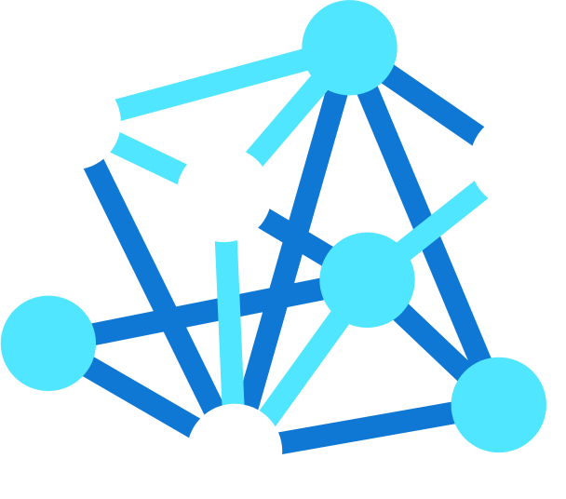
Complex ML models require ‘AI-first’ infrastructure
GPU architecture
Model development
‘AI-First’ infrastructure
Heavily parallelized
Optimization-focused
Purpose-built design
Proven speed & scale
Data-based models
Insight driven
Platform service model
Emerging use cases
Accelerates complex model training & inferencing
Enables real-time responsiveness from the cloud to the edge
Augments performance with deep insights
Empowers more strategic decision making and favorable outcomes
Notes:
Convey that traditionally, HPC and AI were two solitudes before the convergence began…
The “Convergence of HPC + AI” is a phrase that gets thrown around a lot … However, the notion of convergence intended here is precise: Running AI workloads making use of HPC-inspired infrastructure
Talk about the GPU architecture and model development capabilities listed in the slide…

Slide 13







Complex ML models require ‘AI-first’ infrastructure
GPU architecture
Model development
‘AI-First’ infrastructure
Heavily parallelized
Optimization-focused
Purpose-built design
Proven speed & scale
Data-based models
Insight driven
Platform service model
Emerging use cases
Azure
Machine Learning
Azure
Cognitive Services
Notes:
Convey that traditionally, HPC and AI were two solitudes before the convergence began…
The “Convergence of HPC + AI” is a phrase that gets thrown around a lot … However, the notion of convergence intended here is precise: Running AI workloads making use of HPC-inspired infrastructure
Talk about the GPU architecture and model development capabilities listed in the slide…

Slide 14




State of affairs
Seven of the top ten ranked supercomputers worldwide align to the HPC scale up/out infrastructure model
Five of the top 35 ranked supercomputers worldwide are running on Microsoft Azure – includes a Top-10 ranking
Nine of the top ten ranked supercomputers worldwide use NVIDIA Ampere A100 GPU accelerators
7/10
5/35
9/10
Source: https://top500.org/lists/top500/2021/11/
Notes:
Scale-up-and-out infrastructures based upon NVIDIA GPUs and Mellanox Infiniband interconnect fabrics rank amongst the most-powerful supercomputers on the planet
Azure placed within the top 10 on the Top500 and has four more placements within the top 35 – a remarkable and notable first for the public cloud
https://top500.org/lists/top500/2021/11/
https://top500.org/lists/green500/2021/11/

Slide 15
Solution Components

Slide 16
HPC Resource Stack on Azure
Transformative Services
Azure Machine Learning
Azure Data Lake
Azure ML Compute
Workload Orchestration
VM Scale Sets
Azure Batch
Azure CycleCloud
Fast, Secure Networking
ExpressRoute
InfiniBand
High Performing Storage
Azure HPC Cache
Azure NetApp Files
Clusterstore
Optimized Compute
H-Series
N-Series
Cray
Notes:
Now, if you haven’t looked at Azure in a few months, you may be surprised to see what we have these days.
This is the high-level map of the class of services that we offer. We have well over 200 products and services.
You’ll notice we’ve extended to the edge. The ability to run application code in the cloud but also in that seamless, consistent way in the edge is informing our edge investments, whether it be Azure Stack, Azure Sphere, all the way to the Hololens and our Mixed Reality capabilities – these are powerful Edge devices that work in connection with the cloud.
You’ll see we have dev tools, devOps and great innovation, to the core infrastructure and PaaS services that we offer.
TRANSITION: Overall, this gives you the scope of what Azure as a platform and service can do for you.

Slide 17
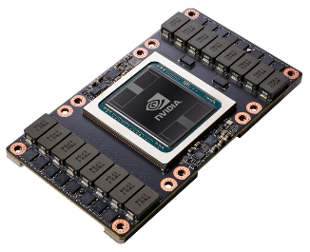
NVIDIA in Azure
Broad offering with the N-series
GPUs from M60 to V100 to support ML & DL training & inference, HPC across industries and Graphics workloads
Integration with key Microsoft solutions
like AML and ONNX for end-to-end acceleration for the most complex workloads, reducing burden of producing world-class solutions
Versatility across applications and frameworks
to support engineering on one platform and solution for the entire team, regardless of the preferences of particular engineers
All NVIDIA acceleration software housed in NGC
via Azure marketplace to ensure users have the easiest experience packaging what they need to achieve best performance in no time.
Optional InfiniBand interconnect
enables scale-up performance
Notes:
All NVIDIA acceleration software housed in NGC via Azure marketplace to ensure users have the Easiest experience packaging what they need to achieve best performance in no time.

Slide 18
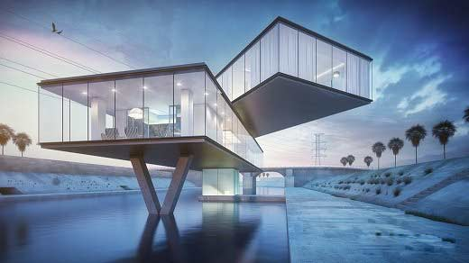

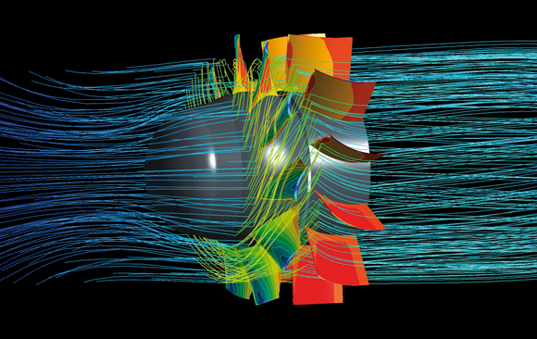
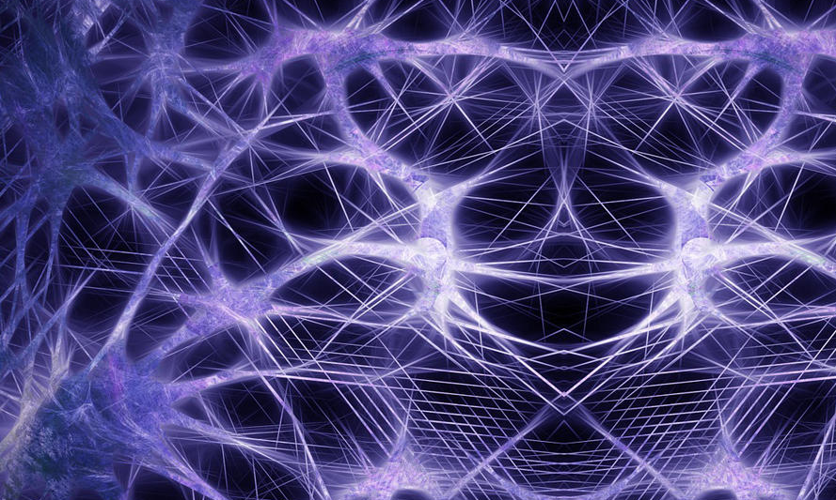
GPU Computing
Visualization
Rendering
HPC/Simulation
Deep-Learning/AI
NV
NC
ND
Workload centric PCs & Workstations
Variable configuration for GPU workstations for content consumption
Modern workspace for interactive collaboration
Scale out using IB for multimode HPC and ML workloads on any MPI stack
Scale-up multi-GPU VMs with fast NVLINK interconnect for high-density single box training and HPC workloads

Slide 19
GPUs for Compute (NC) & Visualization (NV)
Azure Instance → | NC | NCv2 | NCv3 | NCasT4_v3 | NC A100 v4
Cores | 6, 12, 24 | 6, 12, 24 | 6, 12, 24 | 4, 8, 16, 64 | 24, 48, 96
GPU | Tesla K80 | Tesla P100 | Tesla V100 | Tesla T4 | A100 Tensor Core
Memory | 56/112/224 GB | 112/224/448 GB | 112/224/448 GB | 28/56/110/440 GB | 220/440/880 GB
Local Disk | 340/680/1440 GB SSD | 736/1474/2948 GB SSD | 736/1474/2948 GB SSD | 180/360/2880 GB SSD | 1123/2246/4492 GB
Network | Azure Network + InfiniBand (largest size only)
compute
Azure Instance → | NV | NVv3 | NVv4 | NVads A10 v5
Cores | 6, 12, 24 | 12, 24, 48 | 4, 8, 16, 32 | 6, 12, 18, 36, 72
GPU | Tesla M60 | Tesla M60 | Radeon Instinct MI25 | A10 Tensor Core
Memory | 56,112,224 GB | 112/224/448 GB | 14/28/56/112 GB | 55/110/220/440/880 GB
Local Disk | 340/680/1440 TB SSD | 320/640/1280 GB SSD | 88/176/352/704 GB | 180/320/720/1400 GB
Network | Azure Network
visualize

Slide 20
GPUs for Deep Learning (ND series)
Azure instance → | ND | NDv2 | ND A100 v4 | NDm A100 v4
CPU Cores | 6,12,24 | 40 | 96 | 96
GPU | 1x, 2x, or 4x P40 GPUs | 8x V100 32 GB (NVLink) GPUs | 8x A100 40 GB GPUs | 8x A100 80 GB GPUs
Memory | 12/224/448 GB | 672 GB | 900 GB | 1900 GB
Local Disk | 736/1474/2948 GiB SSD | 2948 GiB SSD | 6 TB SSD | 6.4 TB SSD
Network | Azure Network + InfiniBand EDR | Azure Network + InfiniBand EDR + NVLink GPU Interconnect | Azure Network + InfiniBand EDR + NVLink GPU Interconnect | Azure Network + InfiniBand EDR + NVLink GPU Interconnect
deep learning

Slide 21
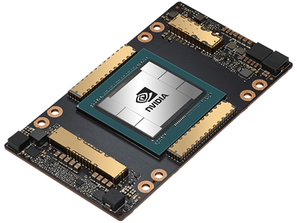
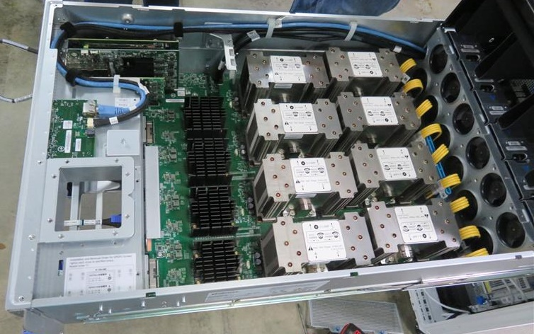
Building Scalable Supercomputers in the Cloud
Single A100 GPU
Multi-GPU VM
NVLINK™
A100 x 8
Multi-GPU VMs
InfiniBand™
A100 x n
NCCL+ NVLink
NCCL+ HDR
Notes:
Pairs of NVIDIA Ampere A100 Tensor Core GPUs are interconnected at 600 GB/s via the NVIDIA NVLINK Bridge
Pairs of GPUs are interconnected via NVIDIA NVswitch (based upon the 64GB/s PCIe Gen4 interconnect)
NVIDIA NCCL provides the software primitives required to make optimal use of this fabric
Mellanox InfiniBand HDR is used as the interconnect fabric
For additional details regarding the Azure ND A100 v4 series VMs see the documentation at https://docs.microsoft.com/en-us/azure/virtual-machines/nda100-v4-series; NVIDIA Ampere A100 Tensor Core GPUs are detailed at https://www.nvidia.com/en-in/data-center/a100/.

Slide 22
ND_v4 Node Topology
CPU 0
Total InfiniBand BW
1.6Tb/s = 8 x 200Gb/s
CPU 1
ib0
ib2
ib0
ib2
PCIe switch
PCIe switch
PCIe switch
PCIe switch
ib1
ib3
ib1
ib3
GPU 0
GPU 1
GPU 0
GPU 1
GPU 0
GPU 1
GPU 0
GPU 1
300Gb/s
300Gb/s
300Gb/s
NVSwitch
300Gb/s
300Gb/s
300Gb/s
300Gb/s
300Gb/s
NVLink3 connectivity
Notes:
Source https://techcommunity.microsoft.com/t5/azure-global/performance-considerations-for-large-scale-deep-learning/ba-p/2693834

Slide 23
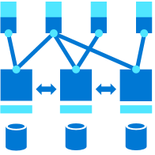
Value of networked GPUs
Scale-up-and-out infrastructures for Deep Learning are built by applying well-established HPC practices
GPUs can be interconnected into an impressive computational resource
GPUs can be programmatically exploited via CUDA for computational purposes
CPUs facilitate computation via communication – they can be mapped to 1 or more GPUs on each server
The MPI allows blocks of data to be exchanged via a high-bandwidth, low-latency InfiniBand interconnect fabric
HPC clusters (HW+SW) can be simultaneously exploited for algorithmic gains
Notes:
This is the value proposition for networked GPUs – the combined impact of parallelism and computation facilitated by communication is substantial
This is why, for example, networked GPUs provide the basis for supercomputers

Slide 24






NVIDIA RAPIDS™ on Microsoft Azure
Azure Machine Learning
Python
Deep Learning Frameworks
CUDF
CUML
CUGRAPH
CUDNN
CUDA
Apache Arrow
GPU-powered N-Series VMs
Microsoft technology
NVIDIA technology
Open-source technology
Notes:
Azure Machine Learning is an all-inclusive solution that can easily leverage the NVIDIA RAPIDS GPU-accelerated libraries
These GPU-accelerated libraries feature implementations of frequently used algorithms (Data Frames, Graph, Machine Learning, Deep Neural Network Library) that have been optimized for execution on GPUs via CUDA
Ultimately, applications execute on N Series VMs on Azure
From Deep Learning frameworks, to Python, Apache Arrow and DASK, Azure ML allows open-source contributions to be leveraged
DASK enables distributed processing for Python applications
Azure Machine Learning service now supports NVIDIA’s RAPIDS | Azure blog and updates | Microsoft Azure

Slide 25
Azure Marketplace images for NDv4
Pre-installed
Drivers – GPU & InfiniBand
CUDA, NCCL and MPI libraries (including rdma_sharp_plugin)
Fully functional after booting up the image

Slide 26

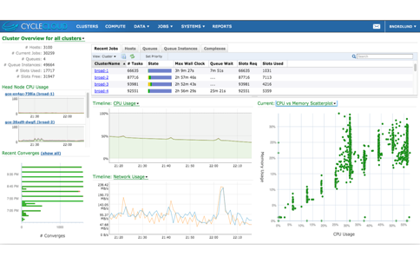
Azure Cycle Cloud
User empowerment
Able to cloud-enable existing workflows and schedulers
Enable instant access to resources
Provide auto-scaling, error handling
IT management
Link workflows for internal and external clouds
Use Active Directory for authentication and authorization
Provide secure and consistent access
Business management
Able to link usage to spend
Provide tools to manage and control costs
Notes:
Like Batch, Azure CycleCloud enables access to the Big Compute resources that Azure provides. Unlike Batch, which runs jobs in Azure, CycleCloud runs compute clusters. It is designed to allow line of business IT groups to provide easy access to cloud clusters for their users. Azure CycleCloud also features tools for managing the flow of data and compute jobs between internal and cloud clusters. Jobs can run where they’re best suited based on the specific requirements and the current resource utilization.

Slide 27

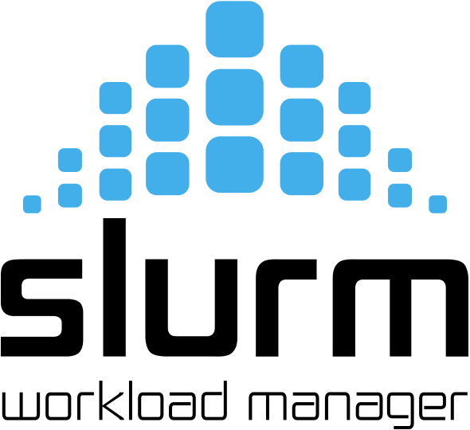






Support for Traditional Job Schedulers
Symphony

Slide 28
Feature Focus: SLURM Integration
Advanced CycleCloud + SLURM HPC job scheduler Integration!
Brings the following autoscaling capabilities to Slurm clusters:
Burst on-premises Slurm clusters to Azure
Slurm clusters can now auto-scale across different VM families
Autoscaling for MPI jobs in Slurm are now placement group aware
“I must offer compliments on CycleCloud 7.8; it's interacting very smoothly with SLURM. Nodes spin up and spin down as expected ...and provisioning is happening much more quickly and reliably. Honestly - kudos; CycleCloud is now working great!”
-- Happy Customer

Slide 29

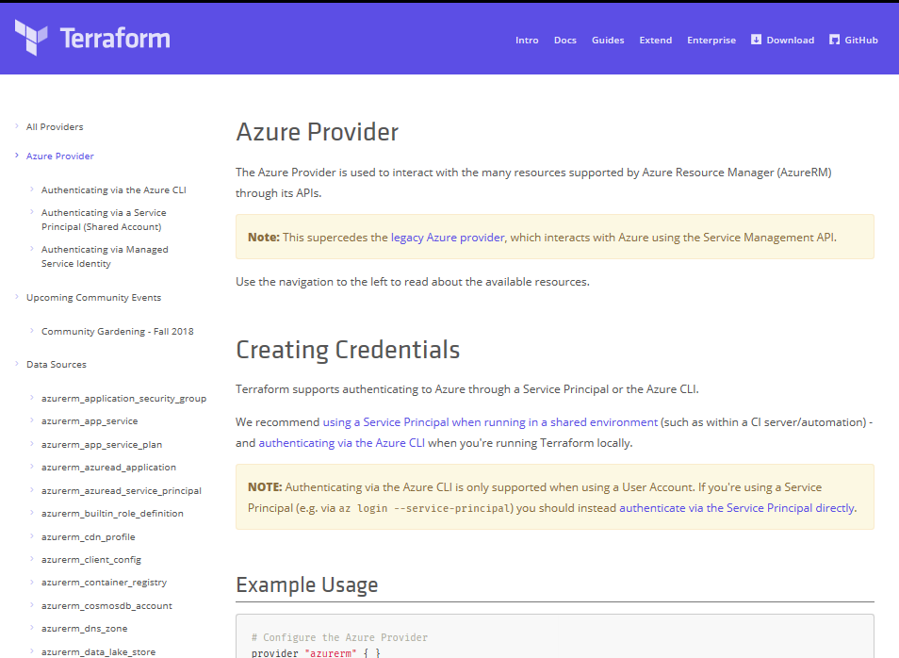
Terraform
Azure DevOps Tool Integrations
Bringing native Azure support for customers using Terraform
Documentation Hub for Terraform
Terraform in Azure Cloud Shell
Azure Resource Provider
Azure Module Registry
Azure Cloud Shell Integration
➔
docs.microsoft.com/azure/terraform

Slide 30
Solution Implementation

Slide 31
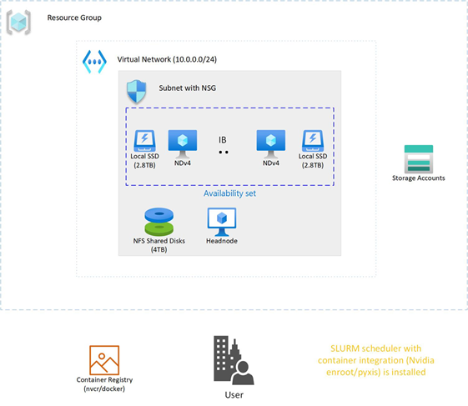
Simplified architectural schematic

Slide 32
Hands-On Exercises

Slide 33
Hands-On Overview
Deploy the required infrastructure
Explore the deployed infrastructure
Tune & health check the deployed infrastructure
Deploy Deep Learning framework & application
Left as an exercise …
Decommission the infrastructure

Slide 34
1-Click Deployment
Facilitated via HashiCorp Terraform
Deploys the entire Azure CycleCloud infrastructure
Includes components plus required scripting
Slurm workload manager
NDv4 VMs with a custom software image
Curated via GitHub

Slide 35
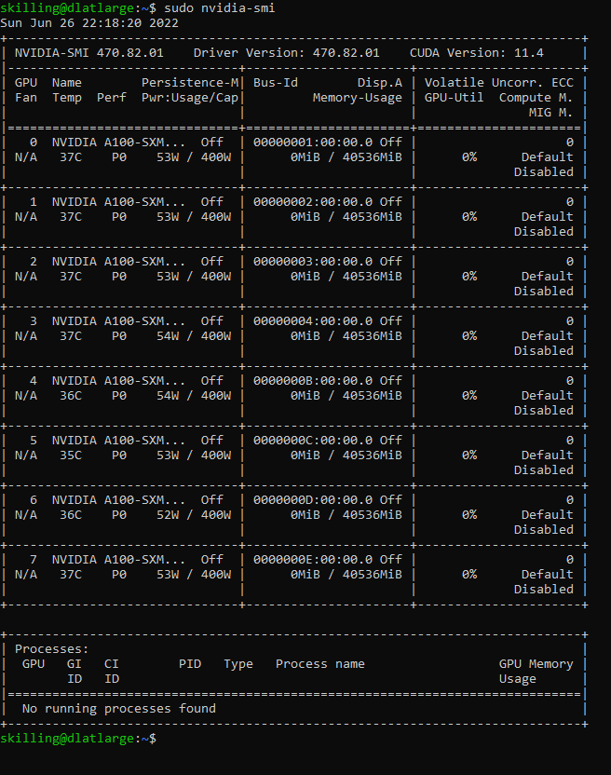
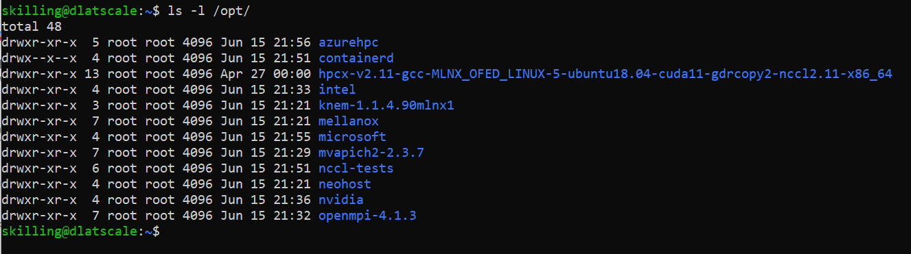
Explore the deployed environment
Image BoM
GPU status

Slide 36






GPU-optimized Software on Azure
Enterprise ready software | Performance optimized | Secure
100 + containers
100+ pre-trained models
Industry frameworks
Helm charts
Collections
HPC | DL | ML
Computer vision | NLP
CLARA | JARVIS | ISAAC
TRITON | GPU operator
CLARA DISCOVERY | TLT-JARVIS | RECSYS
NGC Catalog
ND
NDv2
ND A100 v4
NC
NCsv2
NCsv3
NCas T4 v3
NVIDIA P40
NVIDIA V100
NVIDIA A100
NVIDIA
K80
NVIDIA
P100
NVIDIA V100
NVIDIA T4

Slide 37
Training Code
Python, C, etc.
Microsoft DeepSeed
Onnx Runtime(ORT)
Training Framework
Pytorch, TensofFlow, Caffe, CNTK, etc.
MPI
(HPCX Recommended)
NCCL RDMA
SHARP Plugins
NVML, cuDNN, etc.
NCCL
CUDA (Compliers, Libraries and Tools)
Sepcific Driver (e.g. MLX & Nvidia GPU)
H/W Infiniband HCA + PCIe + Nvswitch/NVlink

Slide 38
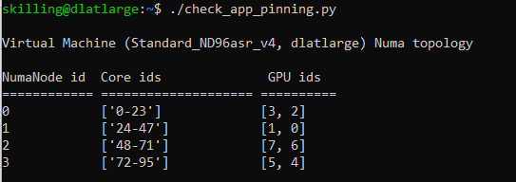
NDv4 tuning considerations
GPU tuning
NCCL tuning
MPI considerations
Process pinning optimizations
Front-end network tuning
I/O tuning
Front-end network tuning
Notes:
Drill down via the hands-on content into some of these tuning topics

Slide 39
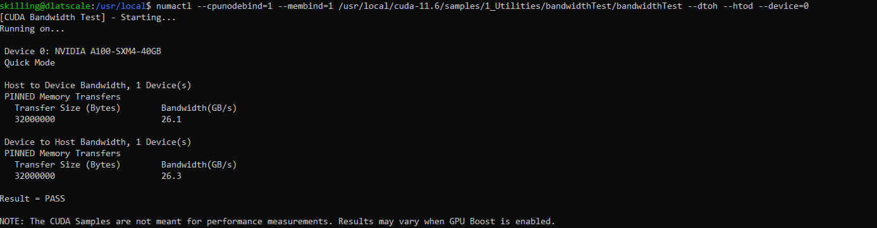
Health checks
Check GPU floating-point performance
Check host to device and device to host transfer bandwidth
Check the InfiniBand network and NCCL performance

Slide 40
Examples of large-scale DL workloads
Fairseq (MOE version) Deep learning training benchmark using docker and SLURM
Training MoE language models

Slide 41
1-Click Decommission
Facilitated via HashiCorp Terraform
Decommissions the entire infrastructure
Removes all components
Curated via GitHub

Slide 42
Summary

Slide 43
Next Steps
ND A100 v4-series documentation: https://docs.microsoft.com/en-us/azure/virtual-machines/nda100-v4-series
Featured resources
Performance considerations: https://techcommunity.microsoft.com/t5/azure-global/performance-considerations-for-large-scale-deep-learning/ba-p/2693834
Running the the Fairseq (MOE version) Deep learning training benchmark: https://github.com/Azure/azurehpc/tree/master/experimental/fairseq_moe_docker_slurm

Slide 44
Agenda
Introduction
Problem Statement
Solution
Components
Implementation
Hands-On Exercises
Discussion

